Slide 1
Hard and Soft Real Time System

Slide 2
Non-Real Time System :
Correct Output (o/p)
Real Time System :
Correct Output + Deadline(given time)
Timing Constant is most important in RTS.
Here, Deadline is defined/given.

Slide 3
Two type of Real Time System (RTS):
1) Hard RTS:
Miss Deadline ==>
Failed/ No Performance/ Utilization = 0
2) Soft RTS:
Miss Deadline ==>
Not Failed/ Decrease Performance/
Utilization > 0

Slide 4
Hard RTS: Miss Deadline ==> Failed/ No Performance/ Utilization = 0
Entire System Process/Task Fails,
No any kind of performance at all,
No or zero utilization.
Example:
If given/defined time is 5 second and if task gets completed at or
before 5 second then only task is considered successful.
And utilization of the running task greater than zero.
Or else if task gets completed after 5 second/ miss given deadline
then task is failed.
And utilization of the running task exactly equals to zero.

Slide 5
Soft RTS: Miss Deadline ==> Not Completely Failed/ Decrease Performance/ Utilization > 0
System Process/Task is not completely fails
Decrease performance.
Decrease utilization but greater than zero after deadline but will be
zero after some additional time.
Example:
If given/defined time is 5 second and if task gets completed at or before 5 second then only task is considered successful.
And utilization of the running task greater than zero.
Also if task gets completed after 5 second/ miss given deadline then task is not completely fail.
And utilization of the running task decrease

Slide 6
Graph:
Time at x-axis
Utilization at y-axis
Task as Bar
Release time & Deadline
See after deadline utilization/performance is zero in Hard RTS.
See after deadline utilization is greater than zero but
Performance/ utilization decreases in Hard RTS.

Slide 7
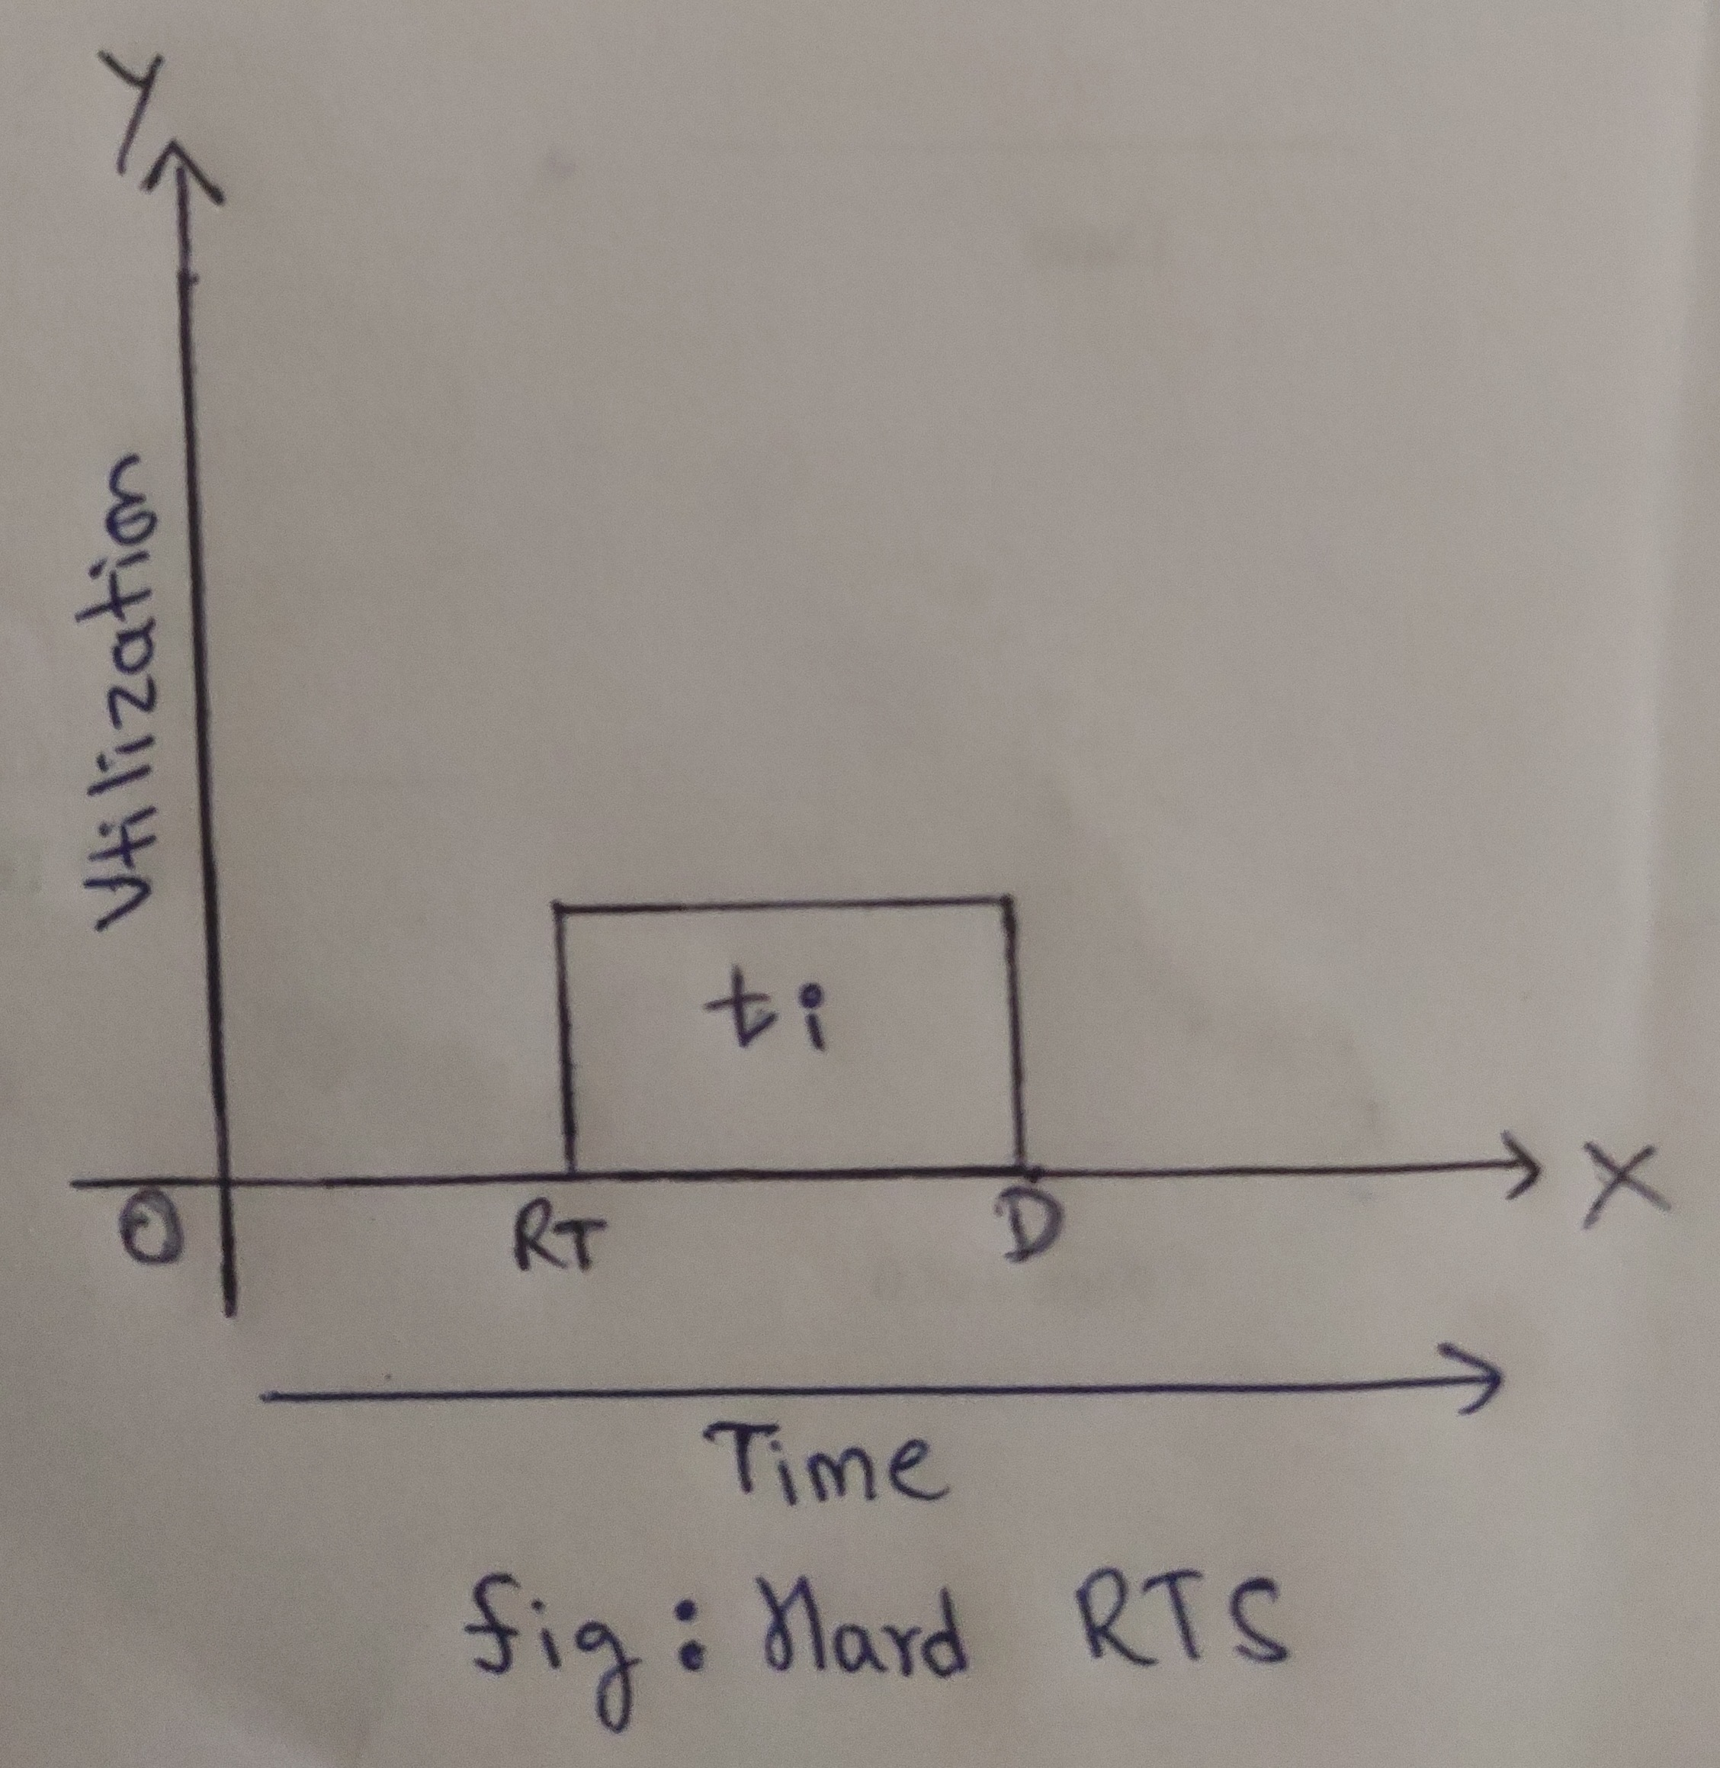
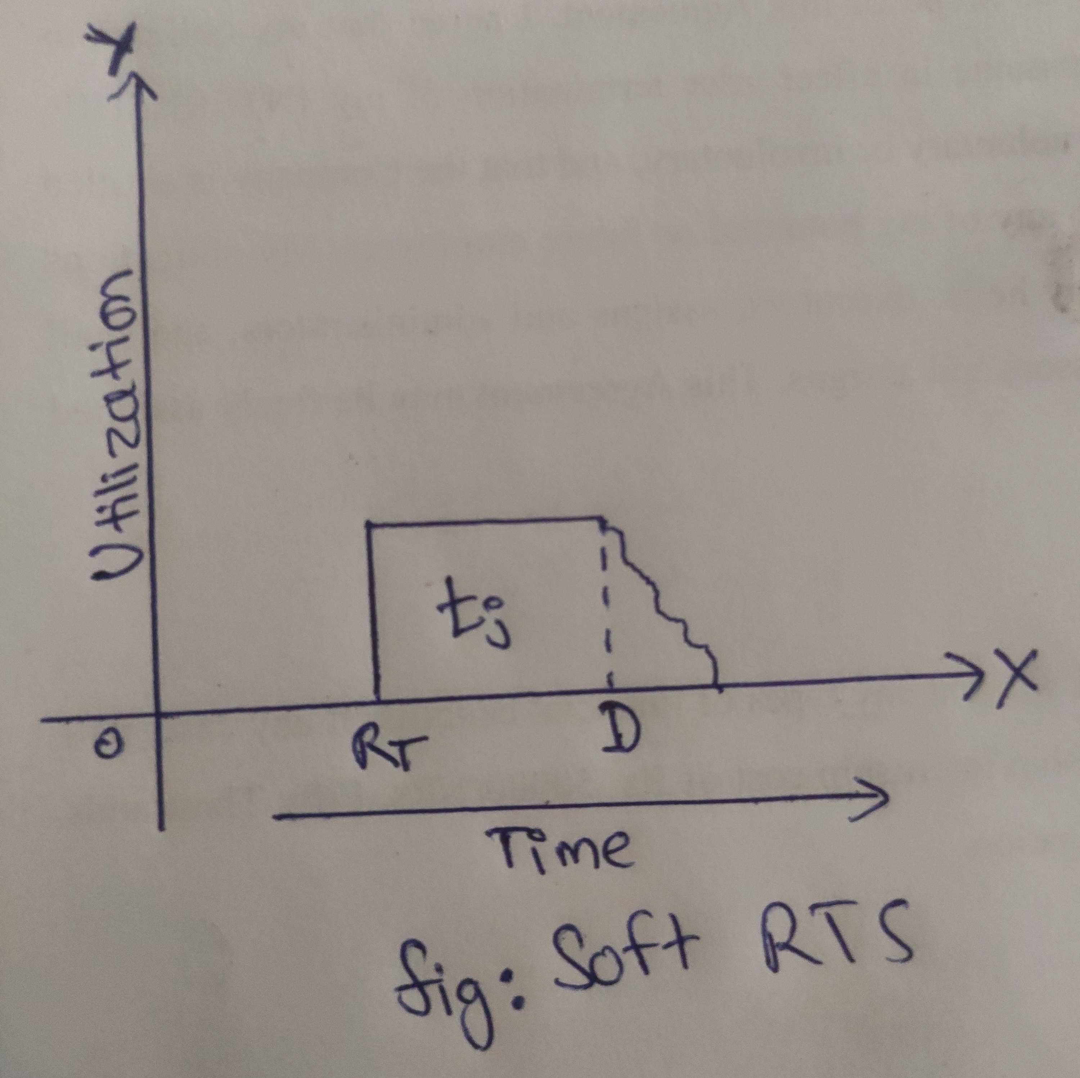
Hard RTS
Soft RTS

